Slide 1
Cs-381 Software Engineering
Course Instructor: Dr. Shazia Arshad
Notes:
Welcome to all of you in this course. I am Dr. Shazia Arshad. I will be your instructor for this course.

Slide 2
What is USECASE??
A use case is a description of how a person who actually uses that process or system will accomplish a goal.
Describes the system's actions from the point of view of a user.
Tells a story: A sequence of events involving Interactions of a user with the system
Specifies one aspect of the behavior of a system, without specifying the structure of the system
Is oriented toward satisfying a user's goal

Slide 3
How do we describe use cases?
Textual or tabular descriptions
User stories
Diagrams

Slide 4
Elements of Use Case Diagram
Actors
Use Cases
System Boundary
Relationships

Slide 5
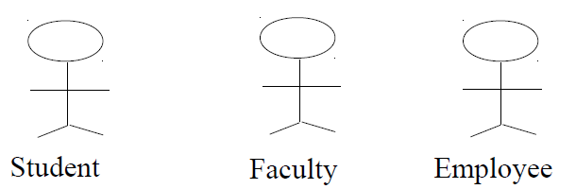
What is an Actor?
An actor is someone or something that must interact with the system under development.
Actors can be human or automated systems.
Actors are not part of the system.
UML notation for actor is stickman and labelled by noun.
Actor has responsibility toward the system (inputs), and Actor have expectations from the system (outputs).

Slide 6
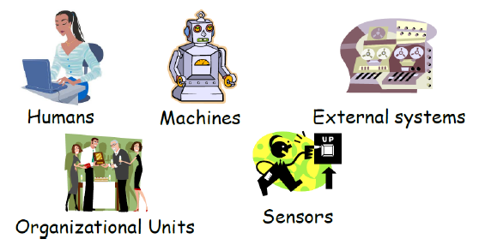
HOW TO FIND Actors?
External objects that produce/consume data:
Must serve as sources and destinations for data
Must be external to the system
Who are the system’s primary users?
Who requires system support for daily tasks?
Who are the system’s secondary users?
What hardware does the system handle?
Which other (if any) systems interact with the system in question?

Slide 7
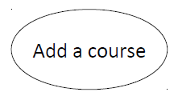
What is a USE CASE?
A use case is a pattern of behavior, the system exhibits.
The use cases are sequence of actions that the user takes on a system to get target
USE CASE is dialogue between an actor and the system, labelled by a verb
A use case may be small or large. It captures a broad view of a primary functionality of the system in a manner that can be easily grasped by non-technical user.
System function, shows what system does.
Each Actor must be linked to a use case, while some use cases may not be linked to actors.

Slide 8
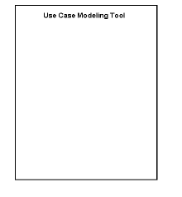
System Boundary
It is shown as a rectangle.
It helps to identify what are use-cases, and what the responsibilities of the system are.
The external environment is represented only by actors.

Slide 9
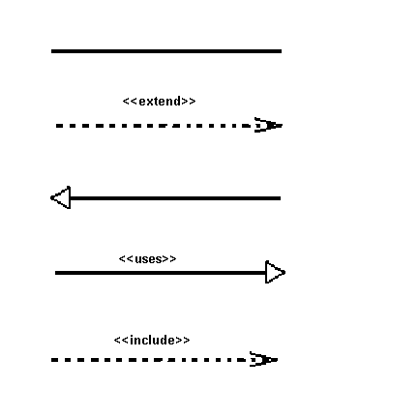
Relationship
Relationship is an association between use case and actor or between multiple use-cases.
There are several Use Case relationships.
Association
Includes / Extends
Generalization

Slide 10
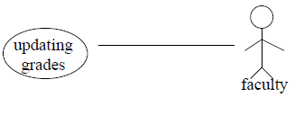
Relationships between Use Cases and Actors
The participation of an actor in a use case is shown by connecting an actor to a use case by a solid link.
Actors may be connected to use cases by associations, indicating that the actor and the use case communicate with one another using messages.

Slide 11
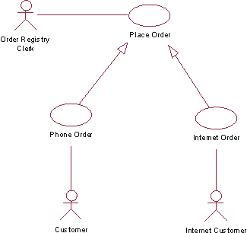
1.Generalization
Generalization is a relationship between a general use case and a more specific use case that inherits and extends features to it.
It is shown as a solid line with a hollow arrow point.
The child use case inherits the behavior and meaning of the parent use case.

Slide 12

2.InCLUDE
The base use case explicitly incorporates the behavior of another use case
The included use case never stands alone. It only occurs as a part of some larger base that includes it.
Include relationships insert additional behavior into a base use case.

Slide 13
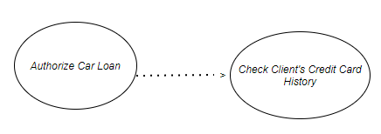
INCLUDE (Cont...)
Include relationship – a standard case linked to a mandatory use case.
Standard use case can NOT execute without the include case _ tight coupling/strong association.
Example: to Authorize Car Loan (standard use case), a clerk must run Check Client’s Credit History (include use case).
The standard UC includes the mandatory UC.

Slide 14

3.Extend
The extended relationship is used to indicate that use case completely consists of the behavior of another use case at one or specific point.
Enables to model optional behavior or branching under conditions.
Arrow points towards base use case.

Slide 15
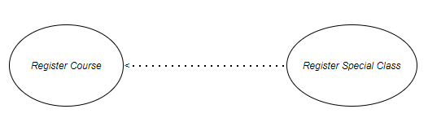
Extend (Cont...)
Extend relationship – linking an optional use case to a standard use case.
Example: Register Course (standard use case) may have Register for Special Class (extend use case) – class for non-standard students, in unusual time, with special topics, requiring extra fees…).
Shapes Class Example.
The optional UC extends the standard UC
Standard use case can execute without the extend case _ loose coupling/weak association.

Slide 16
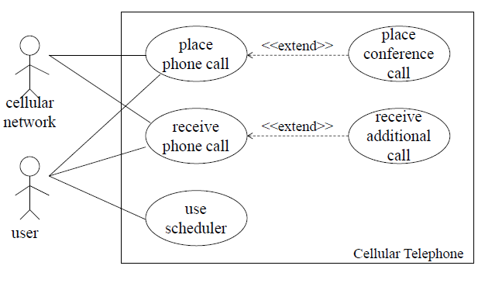
Extend EXAMPLE
Diagram shows example of cellular network.
Place conference call and receive additional call are the optional use cases.

Slide 17
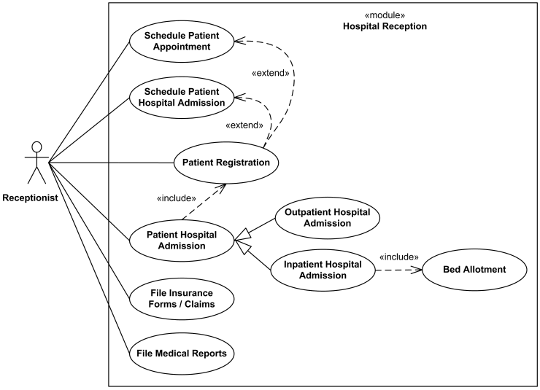
EXAMPLE
Diagram shows example of patient registration system

Slide 18
How to create use case diagram?
1. List main system functions (use cases) in a column:
think of business events demanding system’s response
users’ goals/needs to be accomplished via the system
Create, Read, Update, Delete (CRUD) data tasks
Naming use cases – user’s needs usually can be translated in data tasks
2. Draw ovals around the function labels
3. Draw system boundary
4. Draw actors and connect them with use cases.
5. Specify include and extend relationships between use cases

Slide 19
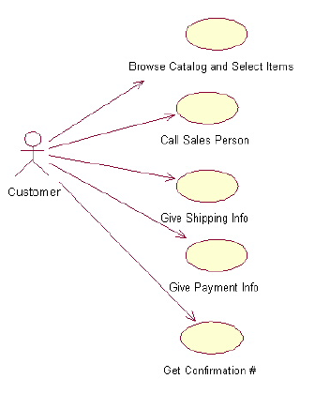
Use-Case Diagrams: Example
I. Begin with a Use Case!
A user placing an order with a sales company might follow these steps :
Browse catalog and select items.
Call sales representative.
Supply shipping information.
Supply payment information.
Receive conformation number from salesperson.
II. Then translate Use Case sequence into Diagram

Slide 20

TIME TO THINK
Draw USE CASE Diagram for your project????

